Slide 1
Bootstrap List
廖向德

Slide 2
Unstyled List

Slide 3
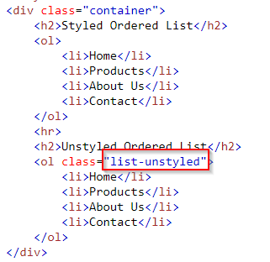
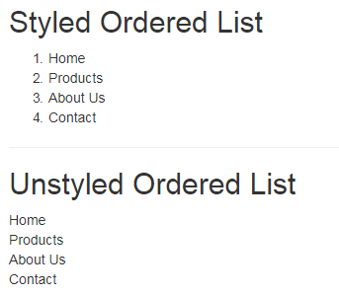
Unstyled Ordered List

Slide 4
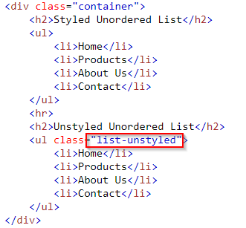
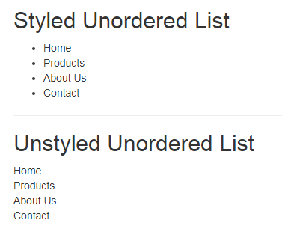
Unstyled Unordered List

Slide 5
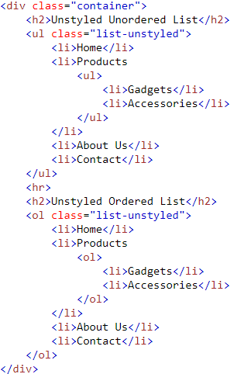
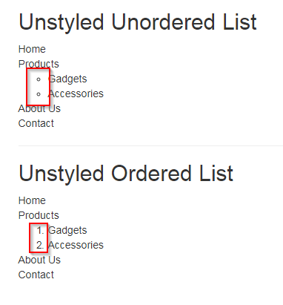
Why child lists still have style? Try and find out.
The .list-unstyled class removes the default list-style and left padding only from the list items which are immediate children of the <ul> or <ol> element.

Slide 6
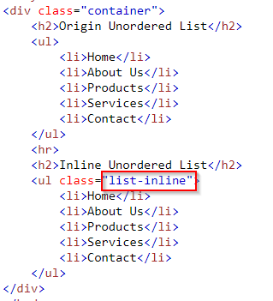
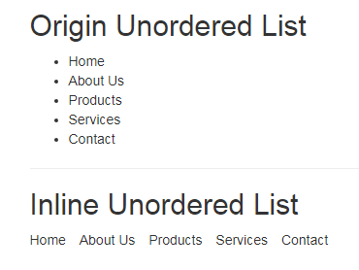
Placing Ordered and Unordered List Items Inline

Slide 7
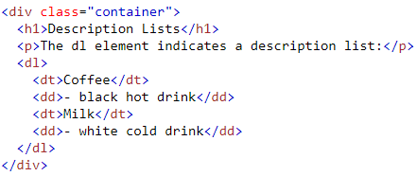
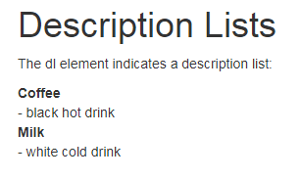
Definition List
<dl> | <dt> | <dd>
Definition List | Definition Term | Definition Description

Slide 8
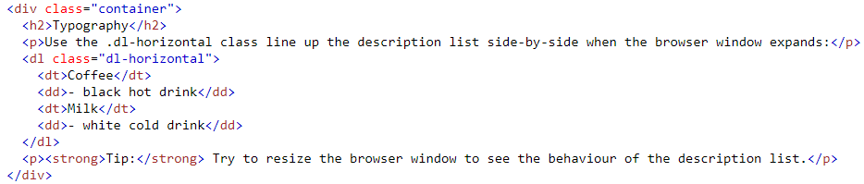
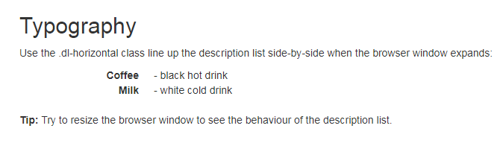
.dl-horizontal

Slide 9
List Group

Slide 10
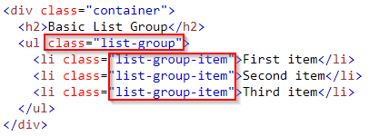
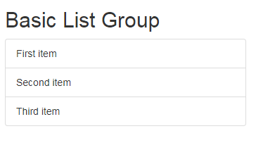
Basic List Groups

Slide 11
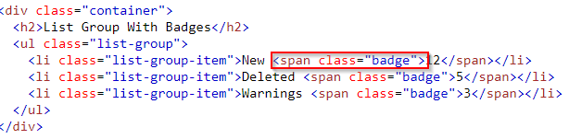
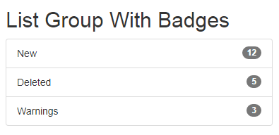
List Group With Badges
To create a badge, create a <span> element with class .badge inside the list item:

Slide 12
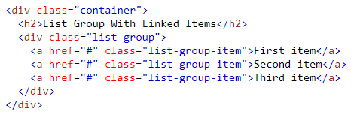
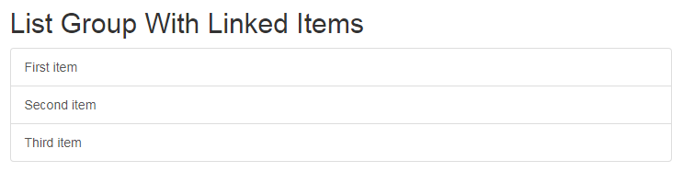
List Group With Linked Items
To create a list group with linked items, use <div> instead of <ul> and <a> instead of <li>

Slide 13
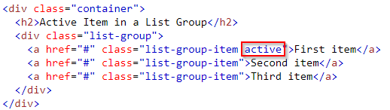
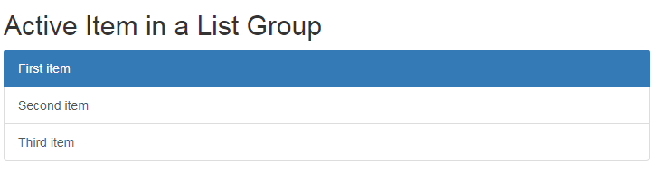
Active State

Slide 14
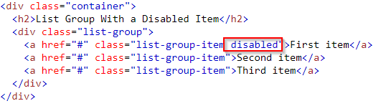
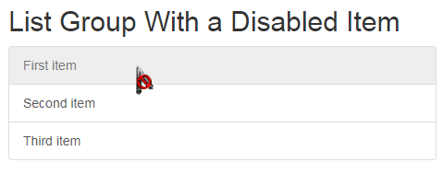
Disabled Item

Slide 15
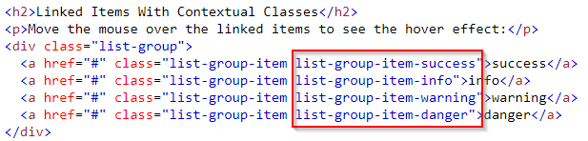
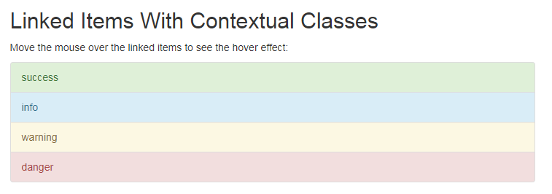
Contextual Classes
https://www.w3schools.com/code/tryit.asp?filename=FKC5A33J4I75
Notes:
<!DOCTYPE html>
<html lang="en">
<head>
<title>Bootstrap Example</title>
<meta charset="utf-8">
<meta name="viewport" content="width=device-width, initial-scale=1">
<link rel="stylesheet" href="https://maxcdn.bootstrapcdn.com/bootstrap/3.3.7/css/bootstrap.min.css">
<script src="https://ajax.googleapis.com/ajax/libs/jquery/3.2.1/jquery.min.js"></script>
<script src="https://maxcdn.bootstrapcdn.com/bootstrap/3.3.7/js/bootstrap.min.js"></script>
</head>
<body>
<div class="container">
<h2>List Group With Contextual Classes</h2>
<ul class="list-group">
<li class="list-group-item list-group-item-success">success</li>
<li class="list-group-item list-group-item-info">info</li>
<li class="list-group-item list-group-item-warning">warning</li>
<li class="list-group-item list-group-item-danger">danger</li>
</ul>
<h2>Linked Items With Contextual Classes</h2>
<p>Move the mouse over the linked items to see the hover effect:</p>
<div class="list-group">
<a href="#" class="list-group-item list-group-item-success">success</a>
<a href="#" class="list-group-item list-group-item-info">info</a>
<a href="#" class="list-group-item list-group-item-warning">warning</a>
<a href="#" class="list-group-item list-group-item-danger">danger</a>
</div>
</div>
</body>
</html>

Slide 16
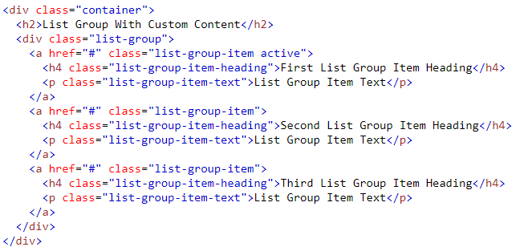
Custom Content (1/2)
You can add nearly any HTML inside a list group item.
Bootstrap provides the classes .list-group-item-heading and .list-group-item-text which can be used as follows:

Slide 17
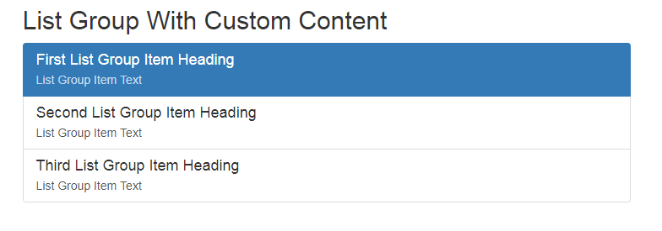
Custom Content (2/2)

